Slide 1
Accounting Cycle II
Adjusting Entries and Financial Statements

Slide 2
Learning Objectives
Need for adjusting entries
Types of adjusting entries
Financial Statement and Balance Sheet
Closing of accounts and post closing trial balance

Slide 3
Adjusting Entries
There is more to the measurement of business income than merely recording simple revenue and expense transactions that affect only a single accounting period.
Certain transactions affect the revenue or expenses of two or more accounting periods.
The purpose of adjusting entries is to assign to each accounting period appropriate amounts of revenue and expense

Slide 4
Adjusting Entries
Trial balance does not provide the information regarding pending transactions
It is necessary to record all the revenues and expenditures which relate to a given period
These were taken into account irrespective of the fact that they are collected or not, paid or not.
Therefore all the outstanding revenues and expenses are recorded or adjusted before final accounts

Slide 5
The Need of Adjusting Entries
Remembering the concept of accounting period
Accounting Period enables decision makers to compare the financial statements of successive periods and to identify significant trends
Measuring net income for a relatively short accounting poses a problem
Because some business activities affect the revenue and expenses of multiple accounting periods.
Adjusting entries are needed at the end of each accounting period to make certain that appropriate amounts of revenue and expense are reported in the company’s income statement

Slide 6
Types of Adjusting Entries
Number of adjusting entries depends upon the nature of business
Most adjusting entries divided into Four general categories
Converting Assets to Expenses
Converting Liabilities to Revenue
Accruing Unpaid Expenses
Accruing Uncollected Revenues

Slide 7
Adjusting Entries and Timing Differences
In an accrual accounting system, there are often timing differences between cash flows and the recognition of expenses or revenue
A company can pay cash in advance of incurring certain expenses or receive cash before revenue has been earned
Likewise, it can incur certain expenses before paying any cash or it can earn revenue before any cash is received

Slide 8
Adjusting Entries and Timing Differences
The timing differences and adjusting entries are,
Converting Assets into Expenses (cash being paid prior to an expense being incurred)
Converting liabilities to revenue (cash being received prior to revenue being earned)
Accrue unpaid expenses (expenses being incurred before cash is paid)
Accrue uncollected revenue (revenue being earned before cash is received)

Slide 9
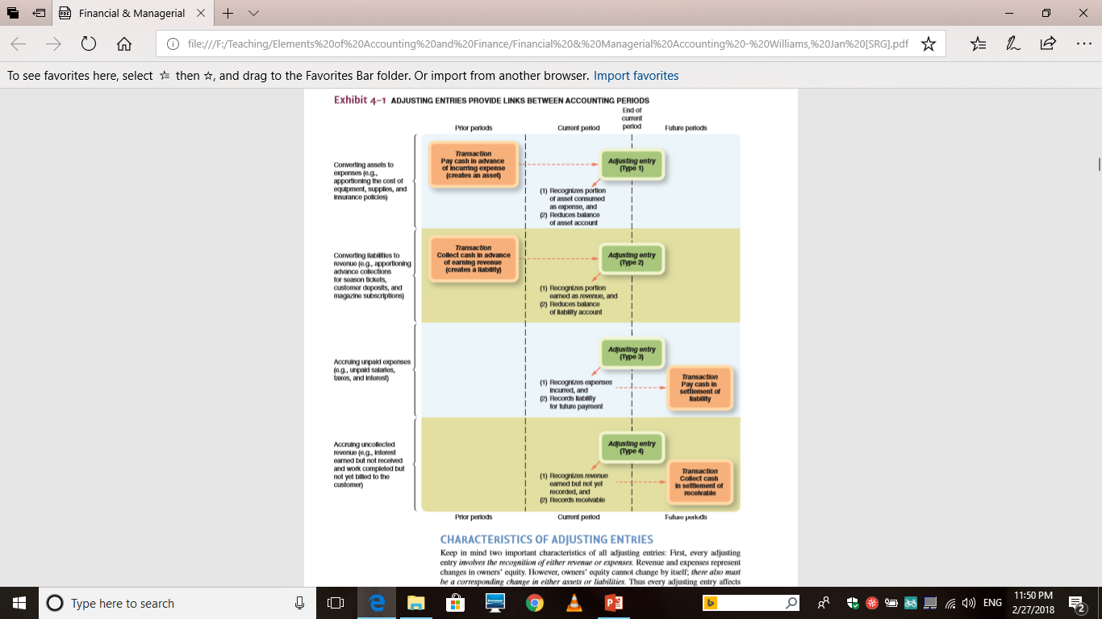

Slide 10
Converting Assets to Expenses
Prepaid Expenses : The expenses which have been paid in advance of their use or consumption.
Two methods of recording
Record as an asset initially
Prepaid Expense Dr.
Cash Cr.
(paid cash in advance for the expense)
At the end of the accounting year an adjusting entry is passed by the amount which is used during the accounting year
Expense Dr.
Prepaid Expense Cr.
(to adjust the expense of the year)

Slide 11
Converting Assets to Expenses
Record as an Expense initially
Expense Dr.
Cash Cr.
(paid cash in advance for the expense)
At the end of the accounting year an adjusting entry is passed by the amount which is unused or unexpired during the accounting year
Prepaid Expense Dr.
Expense Cr.
(to adjust the prepaid expense)

Slide 12
Converting Liabilities to Revenue
Unearned Income: The income which received in advance or recorded before it is earned partly or whole. Advanced payment usually treated as Liabilities
Two methods of recording
Record as an Liability initially
Cash Dr.
Unearned Income Cr.
(cash received in advance)
At the end of the accounting year an adjusting entry is passed for the earned income during the accounting year
Unearned Income Dr.
Earned Income Cr.
(to adjust the earned income

Slide 13
Converting Assets to Expenses
Record as an Income initially
Cash Dr.
Earned Income Cr.
(cash received in advance)
At the end of the accounting year an adjusting entry is passed by the amount which is unearned during the accounting year
Earned Income Dr.
Unearned Income Cr.
(to adjust the unearned income)

Slide 14
Accrue Unpaid Expenses
It means expense payable or expense incurred but haven’t paid yet
Also called outstanding expenses
Adjusting entry is
Expense Dr.
Expense Payable Cr.
(To adjust accrued expense)

Slide 15
Accrue Uncollected Revenues
It means income receivable or income earned but didn’t received and recorded as received
Also called outstanding revenues
Adjusting entry is
Income Receivable Dr.
Income Cr.
(To adjust accrued Income)

Slide 16
References
Williams, J. R., Haka, S. F., Bettner, M. S. & Carcello, J. V. (2012) Financial and Managerial Accounting: The basis of business decisions, 16th edition, Mc Graw Hill
Meigs, R. F., & Meigs, W. B., (1998) Financial Accounting, 8th Edition Mc Graw Hill.

Slide 17
Thank You

